Slide 1
First People of South Dakota

Slide 2
Archaeologists
Dig up old things
Weapons
Tools
Household items (forks, spoons, cups, bowls)
Written records

Slide 3
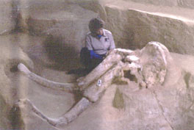

Slide 4
Clovis Hunters
Lived during the prehistoric period (11,000 years ago)
Hunted mammoths
Died away-don’t know why

Slide 5
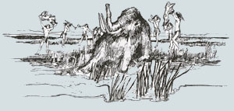

Slide 6
Plains Archaic People
Migrated to South Dakota
Hunted
Buffalo
Deer
Rabbits
Berries
Turnips
Petroglyphs- pictures on a rock
Tell us what these people were like

Slide 7
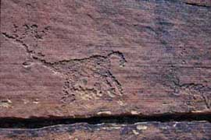

Slide 8
Woodland People
Hunted
Berries
Nuts
Deer
Buffalo
Rabbits
Traded with natives from the area
Built mounds to honor deceased people

Slide 9
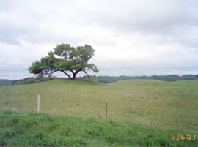

Slide 10
Middle Missouri People
Men hunted buffalo
Women farmed
Corn
Beans
Squash
Tobacco
Sunflowers
Pumpkins
Dug cache pits for storing food
Lived in round mud and clay houses

Slide 11
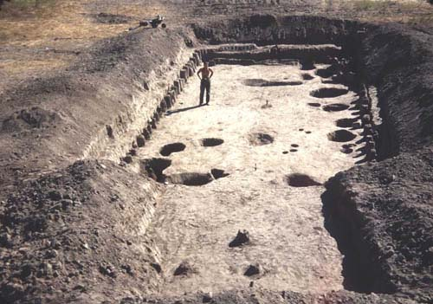
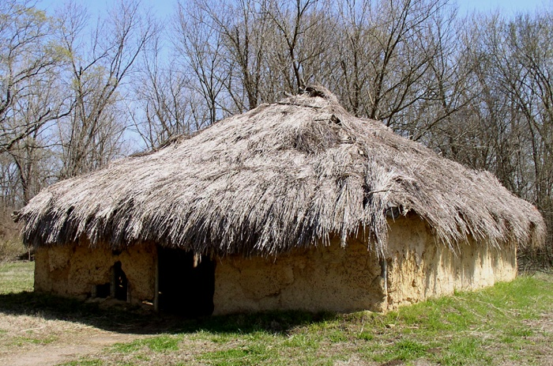
Cache Pit
Daub house
mud and clay

Slide 12
Natives of South Dakota
Arikaras
Sioux
1700

Slide 13
Arikaras
Lived near Missouri River
Built rounded houses & dug them into the earth
Traded corn, tobacco, & vegetables for meat & buffalo hides
Traded for horses with Europeans

Slide 14
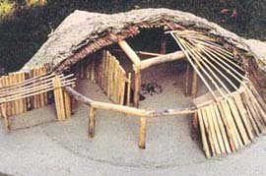

Slide 15
Sioux
Hunted in the deep woods
Fished
Lived in houses made of bark and wood
3 different tribes- had different customs and languages
Dakota
Lakota
Nakota
Lived as nomads- people who move around

Slide 16
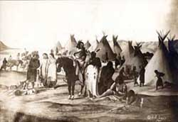

Slide 17
Records
Oral traditions
Told stories of the past
Storytellers memorized stories and passed them from generation to generation
Winter Count
Drew picture on buffalo hide
Drew most important event of the year

Slide 18
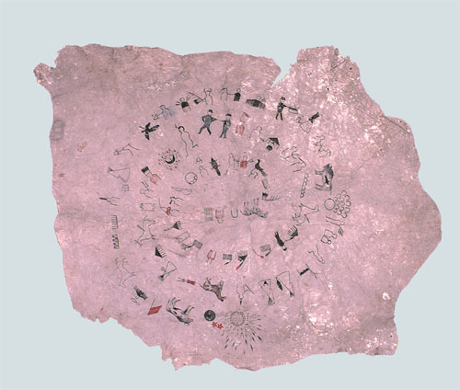

Slide 19
Buffalo (Tatanka)
Used for
Food
Shelter
Clothes
Tools
Hunting Practices
Round up
Buffalo jump
Dressed up as wolves

Slide 20
Europe Claims Land
Great Britain
France
Spain

Slide 21
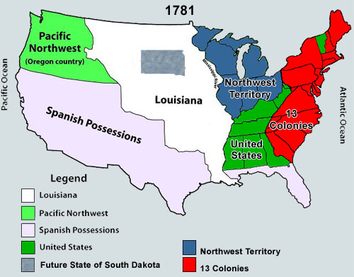

Slide 22
Explorers
1743
LaVerendrye Brothers- France
Buried a lead plate on a hill near Fort Pierre

Slide 23
Lewis & Clark
1804-1806
President Jefferson bought Louisiana Purchase from the French
Asked to explore the Louisiana Purchase for a way to get to the Pacific Ocean
8,000 mile long journey stretching from St. Louis, MO to Pacific Ocean
Sailed through South Dakota 2 times

Slide 24
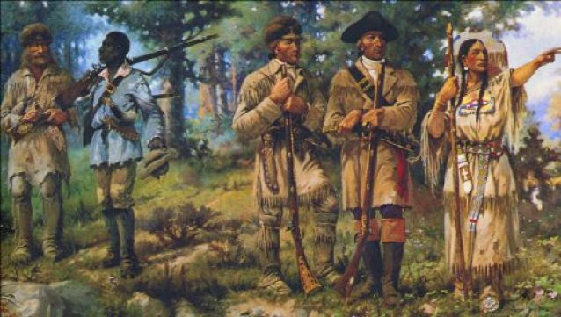

Slide 25
Fur Trade: Booming Business
Missouri River was helpful with fur trade
Brought people to trade furs
Took furs to other states
Took other goods to other states
Many explorers came to South Dakota to start fur trading businesses
Rendezvous- trade meeting between Indians and traders
Traded furs and news
Danced, sang, and feasted together

Slide 26
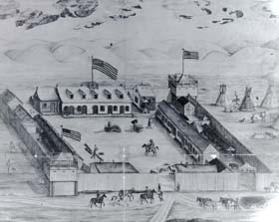

Slide 27
Fur Traders
1806
Manuel Lisa
Fur trader who started the Missouri River Fur Company
1817
Joseph LaFramboise- French-Canadian
Starts fur trading company near Fort Pierre
1831
Pierre Chouteau
Starts American Fur Trading Company near Fort Pierre
Hugh Glass
Jedediah Smith
Notes:
CD: Black Hills- Track 14 1:30 Hugh Glass

Slide 28
Steamboats
Yellowstone
Could carry more cargo and go longer distances
Brought goods and people
Artists, missionaries, and writers
People brought smallpox
Deadly disease
Spread quickly through Arikara villages-Arikaras joined Mandans in North Dakota
Fur trade began to slow down because there were no more buffalo for hunting

Slide 29
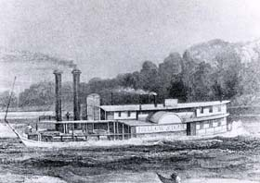

Slide 30
Moving West
Notes:
CD: I-90- Track 15 sodbusters story

Slide 31
Settlers Move Through
Settlers traveled west to Oregon to settle
Settlers drove away wildlife and made buffalo scarce
Indians took from settlers
Oxen
Mules
Horses
Other goods
Settlers and Indians became angry

Slide 32
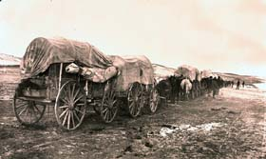

Slide 33
Fort Laramie Meeting- 1851
Indians and United States talked about problems at Fort Laramie
Indians promised:
Stop fighting white settlers and other Indians
Allowed United States to build roads
United States promised:
Keep white settlers off Indian land
Give Indians food and tools
Both didn’t keep their agreement

Slide 34
New Problems-1854
Settlers said a Lakota man stole a cow
Soldiers tried to arrest the man but were killed
General William S. Harney
Led an attack on Lakota camp
Marched to Fort Pierre
Built Fort Randall (at Yankton)

Slide 35
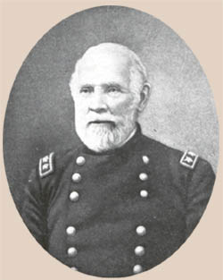

Slide 36
Indian Reservations
John B. S. Todd
Quit army to start a trading post
Talked with Nakota Chief Struck-by-the-Ree
Went to Washington D.C.
Nakota Indians agreed to live on a reserved part of the land called a reservation
United States gave Indians $1,500,000 of food and supply for 50 years for land

Slide 37
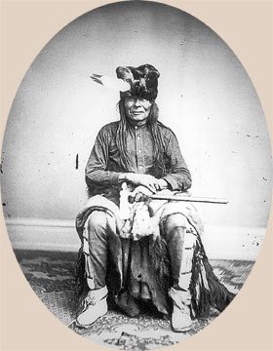

Slide 38
Settlers Move In
Settlers moved to
Yankton
Sioux Falls
Vermillion
Elk Point
Bon Homme
Settlers wanted South Dakota to become a state
President Lincoln created Dakota Territory in 1861

Slide 39
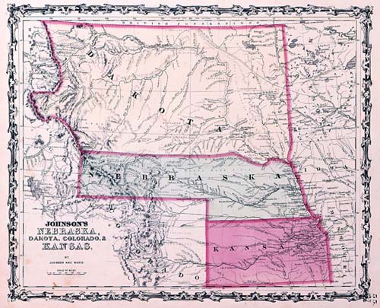

Slide 40
Dakota Territory
William Jayne- first governor of Dakota Territory
Yankton was the capital city
Took a census to see how many people lived in Dakota Territory
Grew slowly because people thought it was too dangerous

Slide 41
Indian Trouble
Indians traded much land to United States for money and supplies
Indians lived on reservations
United States didn’t pay because they didn’t have money
Indians became angry and attacked white settlements
Settlers moved to a fort to have the army protect them

Slide 42
Bozeman Trail
Bozeman Trail opened to allow more people to move west
Indians were scared the white people would take away their lands
Red Cloud, Lakota leader, told the government if they opened the Bozeman Trail there would be a war

Slide 43
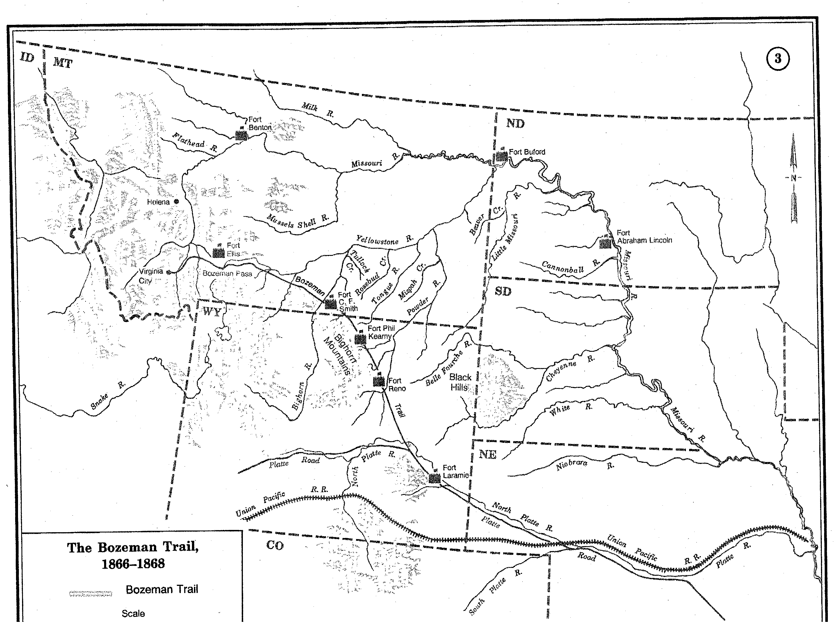

Slide 44
Red Cloud’s War
Lakota warriors attacked wagons traveling along the Bozeman Trail
Army sent soldiers to fight but the Indians killed them
Crazy Horse was a leader in this battle
United States wanted peace
Fort Laramie Treaty ended the war

Slide 45
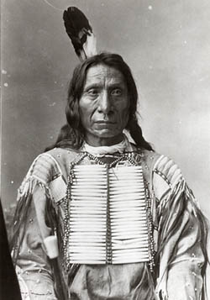

Slide 46
Fort Laramie Treaty of 1868
Bozeman Trail was closed
Indians had to give up land
Paid with money and supplies
Indians were forced to live on reservations
The Great Sioux Reservation
Land west of the Missouri River to the Wyoming border
Included the Black Hills (Paha Sapa)

Slide 47
The Black Hills Gold Rush
1874

Slide 48
Start of the Gold Rush
General George Custer
Order to explore the Black Hills
Look for place to build a fort
Look for gold
Custer found gold
Newspapers wrote about it
White people were not allowed on land because of the Fort Laramie Treaty

Slide 49
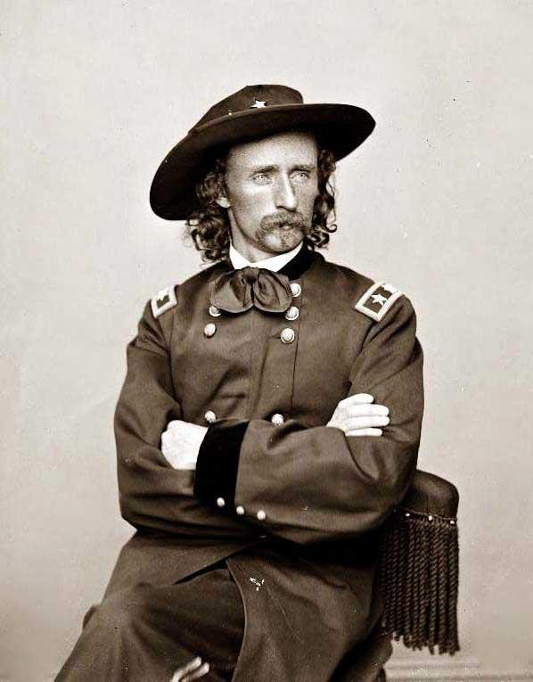

Slide 50
No One Can Enter
Many people went illegally into the Black Hills
The Gordon Party came from Sioux City, Iowa into the Black Hills
Soldiers forced Gordon Party to leave
Soldiers gave up trying to keep people from coming into the Black Hills

Slide 51
Indian Trouble Again
Indians went off the reservations to hunt
Indians refused to go back until they were done hunting

Slide 52
Battle of the Little Bighorn
General Custer led an attack on Indians
Custer didn’t wait until the other armies came to help
All of Custer’s army was killed

Slide 53
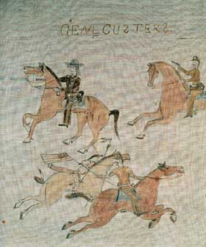
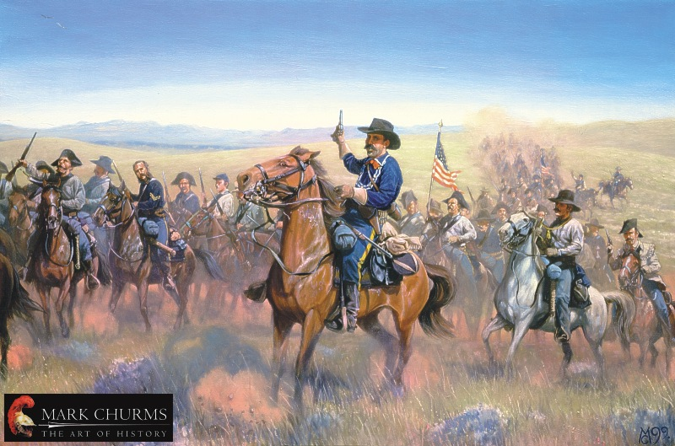

Slide 54
Gold Rush Boom
1876 – 25,000 people lived in Black HIlls
Many different people came
White settlers
Chinese
Blacks
Other immigrants
People found gold near
Custer
Hill City
Deadwood
Lead

Slide 55
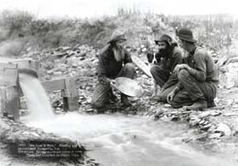

Slide 56
The Great Dakota Boom
1880s

Slide 57
Railroads Arrive
2 railroad companies came through Dakota Territory
Chicago North Western Railroad
Chicago Milwaukee, and St. Paul Railroad
Railroads covered all of eastern Dakota Territory within 10 years
Railroads helped towns grow
Railroads shipped crops and livestock

Slide 58
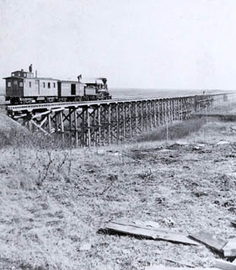
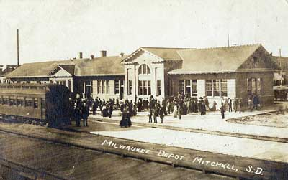

Slide 59
Population Increases
Farmers raced to start farming
Homestead Act of 1862
Many got free homesteads
Homesteads were 160 acres
Had to live there for 5 years
Southern Dakota Territory exploded
82,000 – 1880
249,000- 1885
329,000- 1890

Slide 60
Growth of Towns
Towns grew along the railroad
Stores filled Main Streets
Hardware stores
General stores
Newspapers
Railroad depots were the busiest places
Schools
Churches

Slide 61
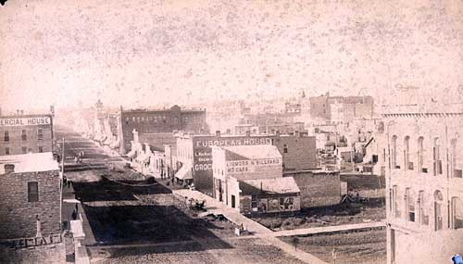

Slide 62
Growth of Agriculture
East River
Farming done with oxen and horses
Wives and children helped
Planted wheat, corn, soybeans
Raised cattle, hogs, sheep
West River
Ranching- raise cattle
Cattle Rustlers stole cattle
Ed Lemmon & James “Scotty” Philip were some of the first cowboys in the west

Slide 63
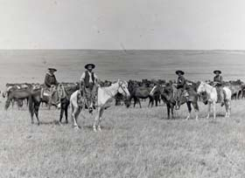
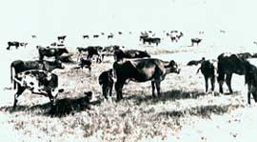

Slide 64
Immigrants Arrive

Slide 65
Where did they come from?
Immigrants came from:
Eastern states
Southern states
Western states
Foreign countries
Germany
Norway
Poland

Slide 66
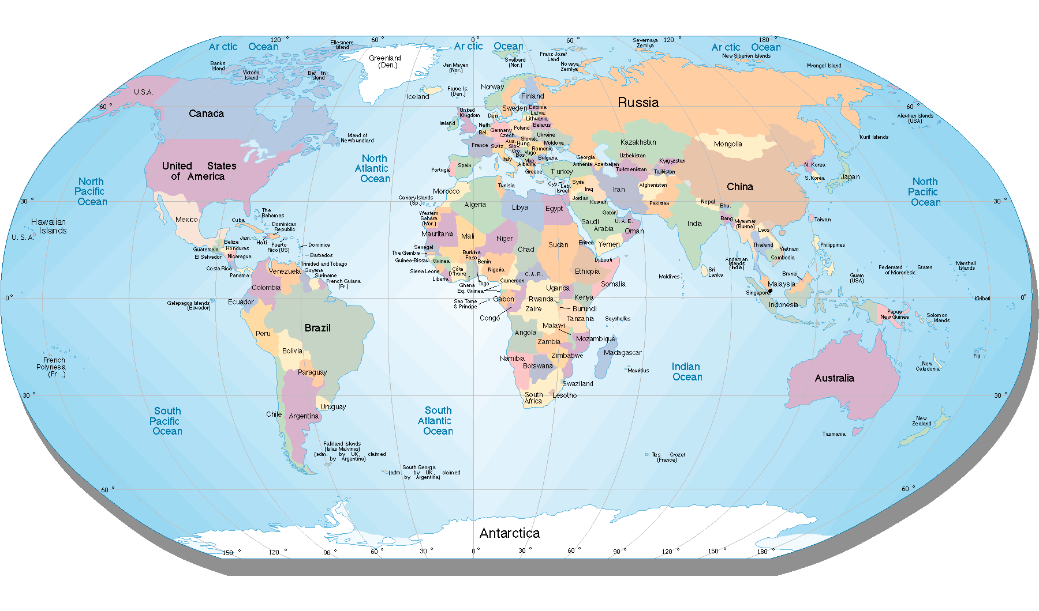

Slide 67
What did they do?
Farmers
Blacksmiths
Hotel Keepers
Cleaning women
Store keepers

Slide 68
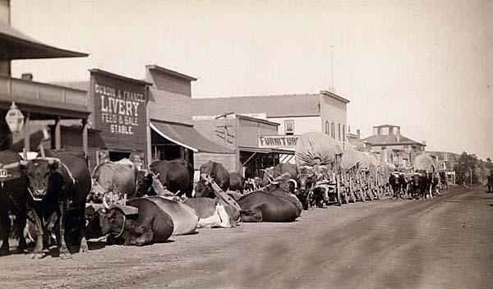
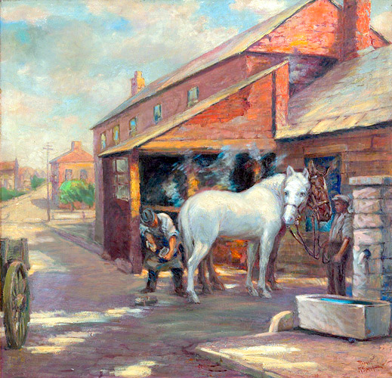
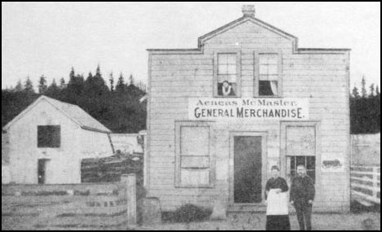

Slide 69
German-Russians
Germans moved to Russia because of their religious beliefs
Didn’t want to join the army
Russia said they wouldn’t have to join the army
100 years later Russia changed its mind and decided they would have to join the army
German-Russians fled to United States
Brought Turkey Red wheat seeds to plant

Slide 70
Hutterite Colonies
Hutterites lived together in colonies
Didn’t have private property
Ate together
Spoke German language
Successful farmers; used old and new ways of farming

Slide 71
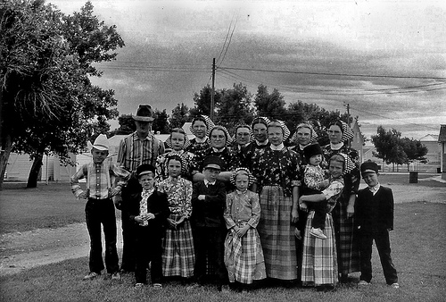

Slide 72
Native Americans
White people took their land
Forced to live like white people
Buffalo were driven away or killed
Children were sent to boarding schools
Use of native language was forbidden
Couldn’t perform religious ceremonies
Reservations became smaller
Poor farming land
After 1890, there were 7 reservations

Slide 73
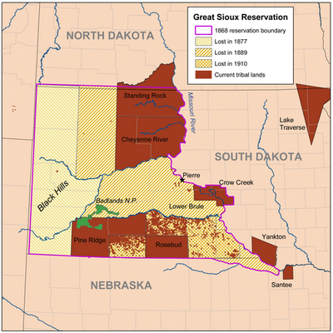
Notes:
Reservation map

Slide 74
Statehood of South Dakota
November 2, 1889

Slide 75
Pushing for Statehood
Federal law stated a territory must have 60,000 people to become a state
Dakota Territory had been a territory for 18 years

Slide 76
People Pushing for Statehood
Dr. Joseph Ward- “Father of Statehood”
William Henry Harrison Beadle- in charge of public education in Dakota Territory
Hugh J. Campbell- Lawyer
Richard Pettigrew
Became first South Dakota Senator
Arthur Mellette
Friends with Benjamin Harrison
Appointed governor of Dakota Territory
Elected as first governor of South Dakota

Slide 77
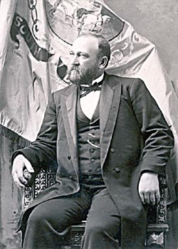
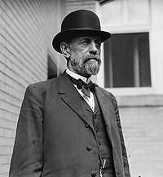
Richard Pettigrew
Arthur Mellette

Slide 78
Becoming South Dakota
President Benjamin Harrison helped pass a law to make South Dakota a state
We had to write a state constitution and have it approved by voters
Constitution was approved in October
On November 2, 1889 South Dakota became the 40th state of the United States

Slide 79
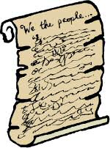

Slide 80
Choosing a Capital City
Bismarck was the capital city in Dakota Territory
Huron and Pierre wanted to be capital
Pierre
More central location
Railroad center
Huron
Growing town
Center of population
Pierre became the capital city

Slide 81
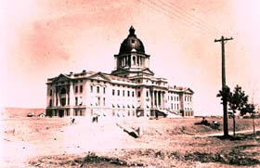

Slide 82
Native Americans in South Dakota
White settlers wanted to open up reservations
1889- Indians signed a treaty that gave 9 million acres of reservation land to the government
This made the Indians angry
Forced to give up land
Didn’t get food and supplies like promised
Buffalo driven out
Not good land to grow crops

Slide 83
The Ghost Dance & Wounded Knee Massacre
Indians were told to do the Ghost Dance to regain power and buffalo
1890- Sioux were doing Ghost Dance
White settlers were afraid
Soldiers were called in to South Dakota
Chief Sitting Bull was killed
Army attacked the Sioux people at Wounded Knee Creek
300 Indians died; 30 soldiers died

Slide 84
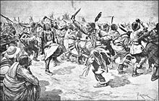
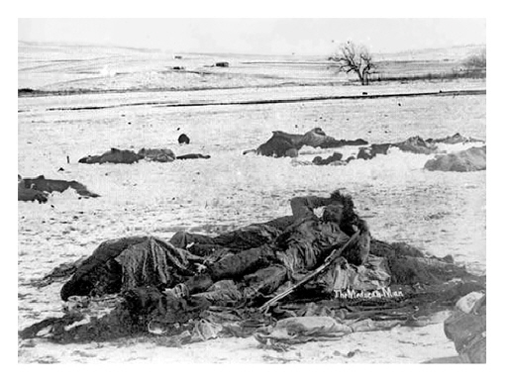
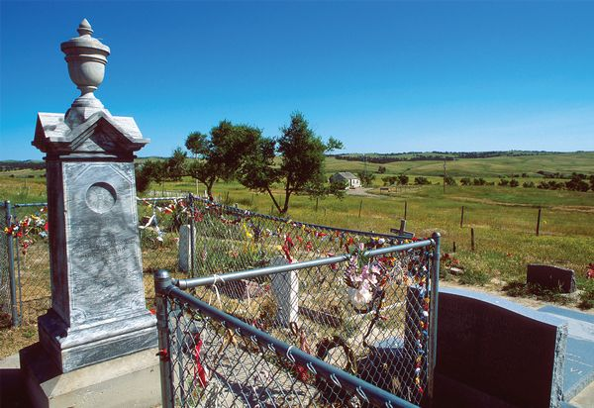
Notes:
Wounded knee picture

